Slide 1
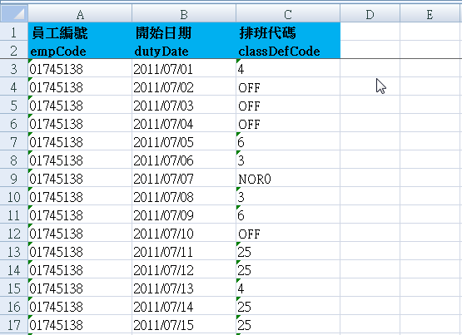
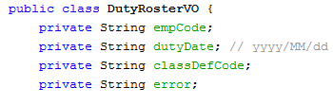
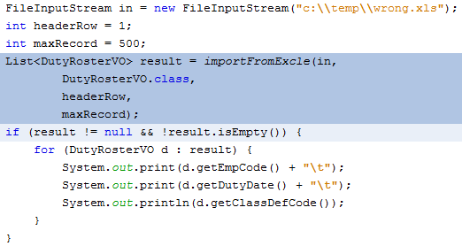
importFromExcel
1. xls or xlsx file
headerRow
2.POJO class
3. Call API
maxRecord

